Slide 1


PREDICTIVE MODELING OF DIABETES RISK FACTORS
______________________________________________________________________________________________
Prof . MAGESH TARALA
BUAN 6356 - Business Analytics With R
PROJECT SUBMITTED BY
Jan, Muneeb Ullah - Mxj230018
Khan, Raja Mamoon - Rxk230029
Dharam, Tanmayee Ashok - TXD220006
VIJAY REFKIN PUVVALA - vxp230008
Yajjala, Jesse Jackson - jxy230003
Nalli, Gladin - Gxn220000

Slide 2
CONTENTS
Predictive Modeling of Diabetes Risk Factors
1. Exploratory Data Analysis
Univariate Analysis
Bivariate Analysis
T-tests to check predictors significance
2. Regression Trees
3. Neural Nets
4. Logistic Regression
5. Models Comparison

Slide 3
DATA SET SUMMARY
- Diabetes dataset has a total of 390 records.
- It contains 16 Predictors in total, 3 are categorical and 13 are numerical variables. Out of the 13 numerical
predictors, 3 are derived attributes.
- In our analysis, we assessed the performance of classifiers by comparing models that incorporate all
predictors with those involving single attributes and derived attributes.
- Following is the breakdown of all Predictors:
Categorical: Patient number, Gender and Diabetes class.
Numerical – Single attribute: Cholesterol, Glucose, HDL Chol, Age, Height, Weight, Systolic BP, Diastolic BP, Waist and Hip
Numerical – Derived attributes: Chol to HDL ratio, BMI and Waist to Hip ratio.

Slide 4
16 - PREDICTORS
Patient number – Number of Patients
Gender - Male and Female
Diabetes class - Diabetes based on gender
Cholesterol - Cholesterol Level
Glucose - Glucose Level
HDL Chol - HDL Chol Level
Age - Age of the Individual
Height - Height of the Individual
Weight - Weight of the Individual
Systolic BP -
Diastolic BP
Waist and Hip
Chol to HDL ratio
BMI
Waist to Hip ratio
Diabetes – Diabetes VS No Diabetes

Slide 5
Exploratory Data Analysis
1. Univariate Analysis
2. Bivariate Analysis
3. T test to check Predictors Significance

Slide 6
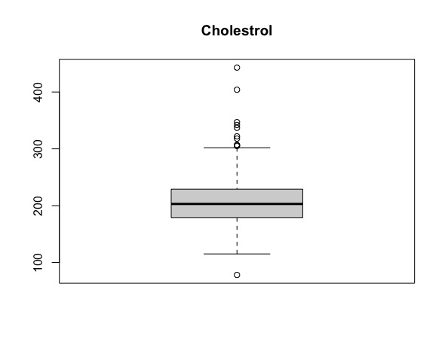
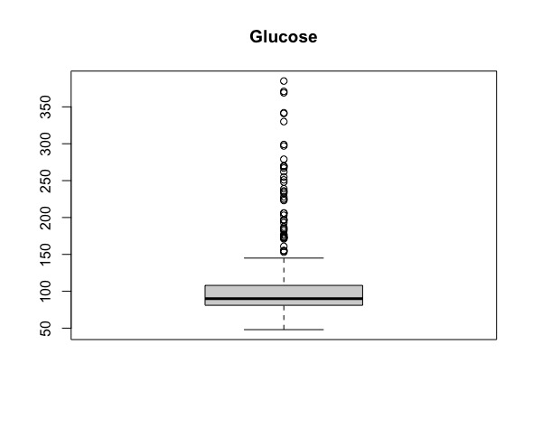
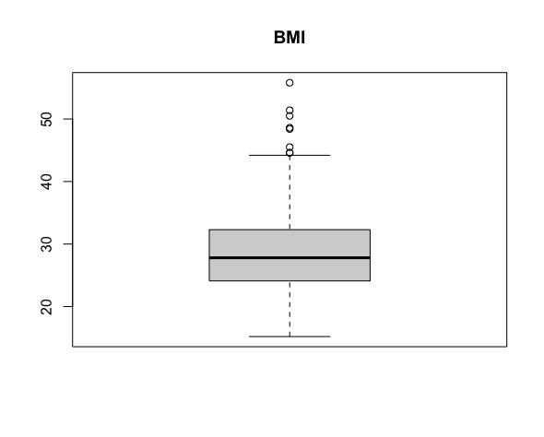
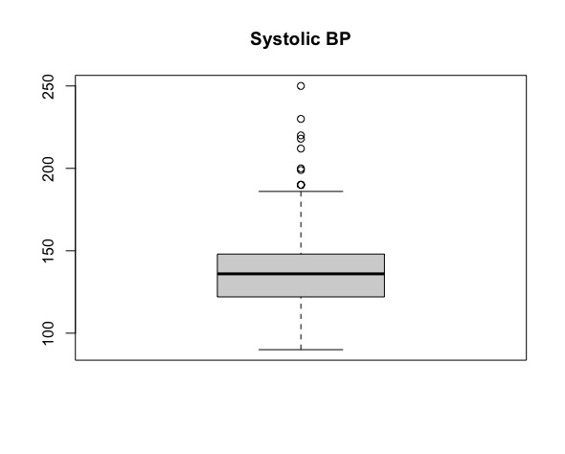
Early Treatment of Dataset:
Removing Patient column as it does not provide any helpful information.
Making data types consistent, converting commas to periods.
No missing values – No data imputation required.
Univariate Analysis:
Checking for Outliers
Removed extreme outliers by data filtering.

Slide 7
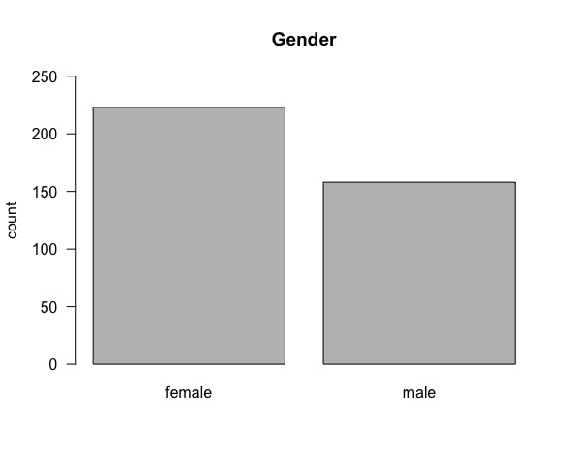
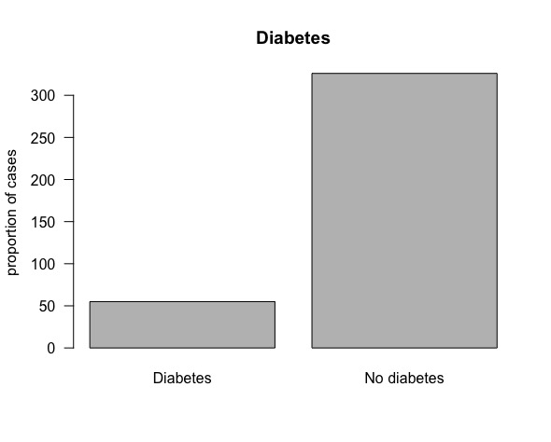
Gender Classification
Diabetes Class Proportion:
Diabetes Class Numbers:
Gender | Count
Male | 158
Female | 223
Diabetes | Proportion
Yes | 14.1%
No | 83.5%
Diabetes | Count
Yes | 55
No | 326

Slide 8
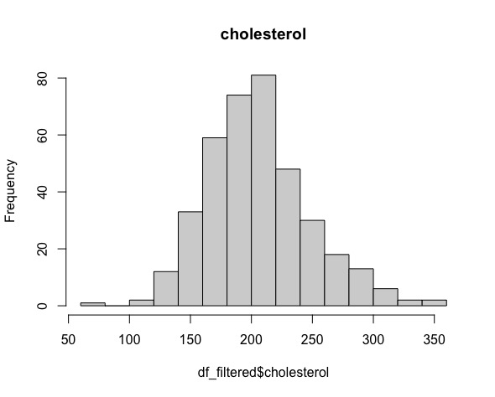
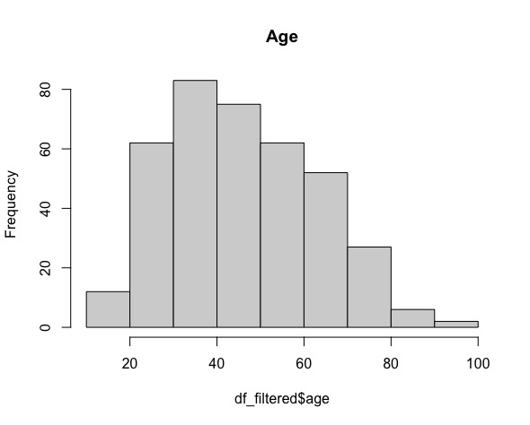
Checking Normality of Predictors
All of the predictors are near normal but not exactly normally distributed. We have used sampling distribution of the sampling mean which is normally distributed to perform statistical analysis. Below are few of the Original Distributions.

Slide 9
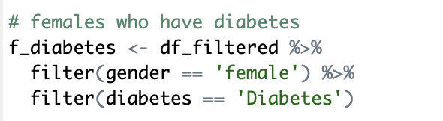
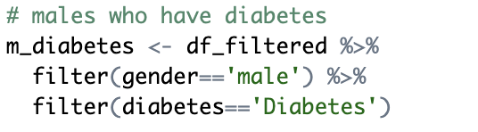
Bivariate Analysis
Diabetes Class based on Gender.
For Females:
Out of 158 women, 32 have diabetes which is 14.35% of the total women count.
For Males:
Out of 158 men, 23 have diabetes which is 14.56% of the total men count.
Count | 32
Proportion of total women | 14.35%
Count | 23
Proportion of total men | 14.56%

Slide 10
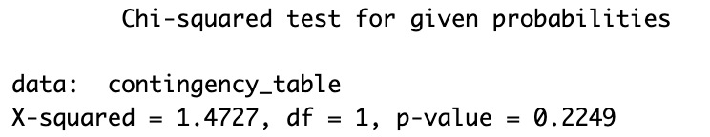
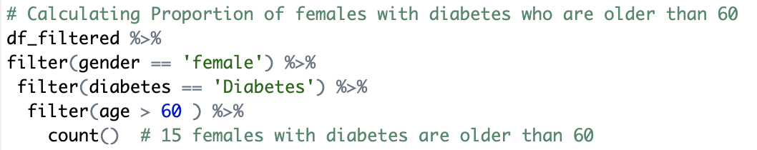
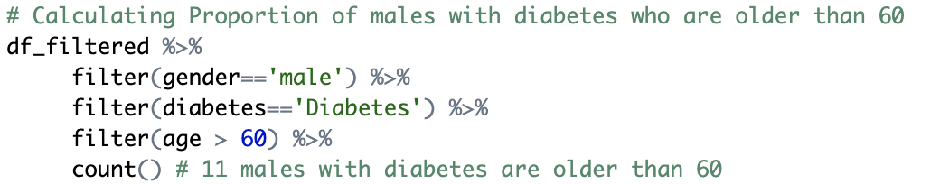
Performing a Chi Square test to check if the difference in proportions is statistically significant.
H0: Proportion of individuals with diabetes is same for males and females.
H1: Proportion of individuals with diabetes is different for males and females.
As the p-value is greater than the threshold significance level, with 95% confidence we can conclude that Proportion of individuals who have diabetes is same irrespective of gender. In simple terms, Gender plays a very small or no role at all in determining if an individual will have diabetes or not.
Testing the Hypothesis that claims older females are more likely to have diabetes. We are considering individuals who are above the age of 60 as old as 60 falls above the 3rd quartile of the Age predictor.
15 females with diabetes are older than 60 which is 0.08% of total female with diabetes.

Slide 11
11 males with diabetes are older than 60 which is 0.07% of the total males with diabetes.
From the above test, we can infer that the probability of having diabetes for both males and females is similar. The 0.01%
difference in proportions is statistically insignificant.

Slide 12
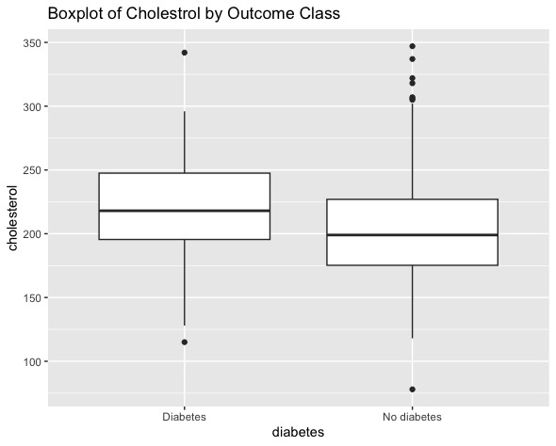
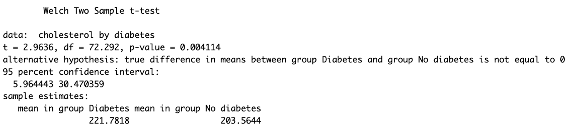
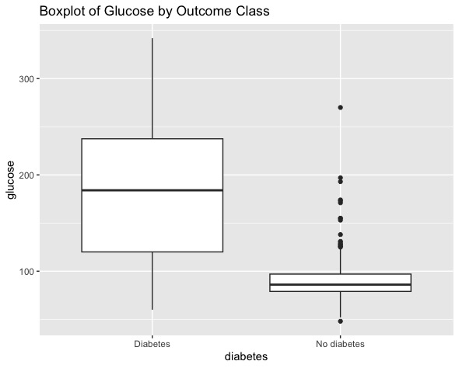
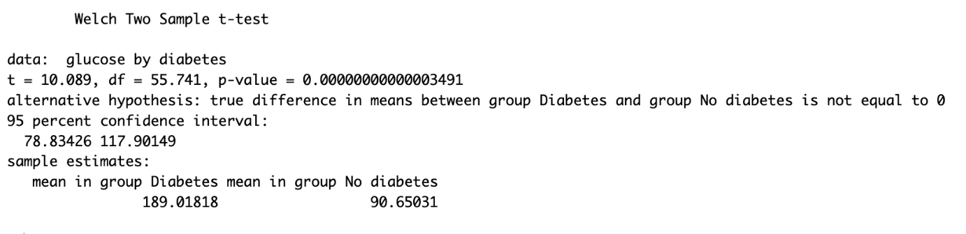
Correlation of Predictors with the Outcome variable
Boxplot of Cholesterol by outcome class along with the T-test to check its
significance:
As the p-value is less than the significance level, we reject the null Hypothesis and conclude that the Cholesterol mean is statistically different in individuals who have diabetes against who don’t have diabetes. In simple terms, Cholesterol is an important factor in determining if an individual has diabetes or not.
Boxplot of Glucose by outcome class along with the T-test to check its significance:

Slide 13
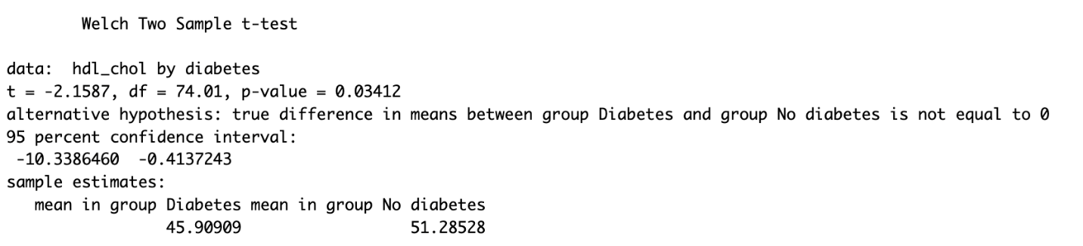
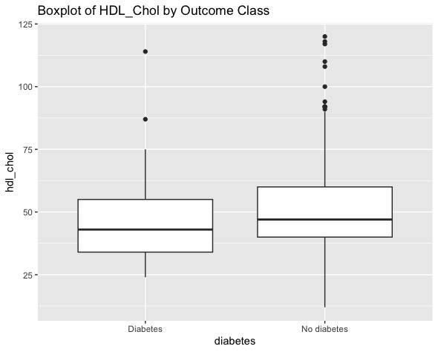
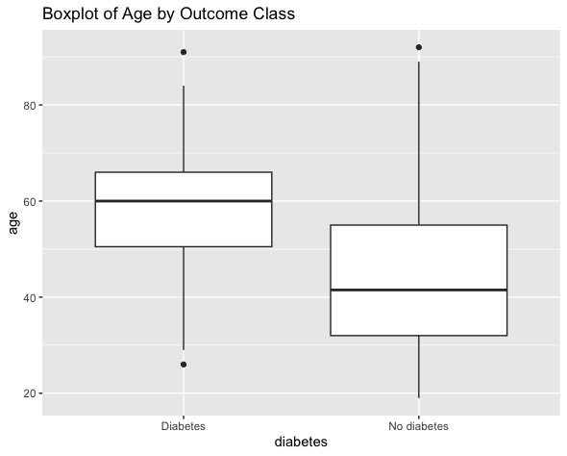
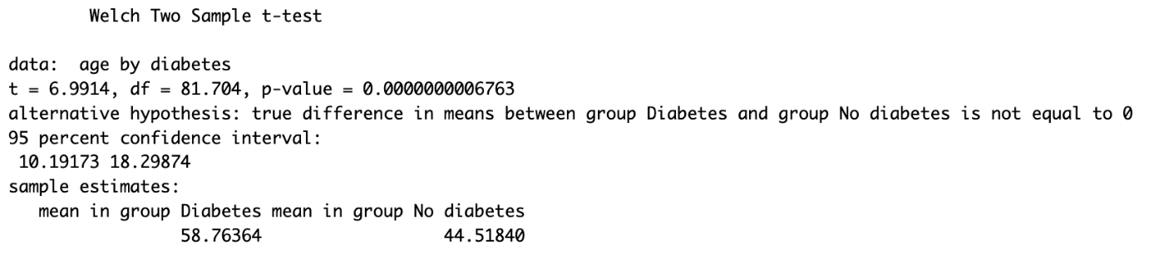
Boxplot of HDL_CHOL by outcome class along with the T-test to check its significance:
As the p-value is less than the significance level, we reject the Null Hypothesis and
conclude that mean HDL_chol level is statistically different in individuals with
diabetes against those who don’t have diabetes. In simple terms, HDL_chol is a
very important factor in determining if an individual has diabetes.
Boxplot of AGE by outcome class along with the T-test to check its significance:
As the p-value is less than the significance level, we reject the Null Hypothesis and
conclude that mean Age is statistically different in individuals with diabetes against
those who don’t have diabetes. In simple terms, AGE is a very important factor in
determining if an individual has diabetes.

Slide 14
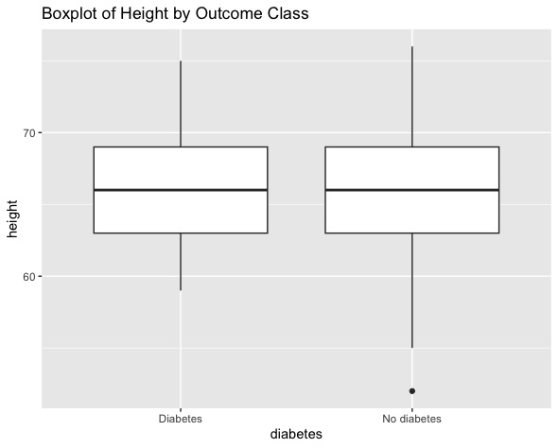
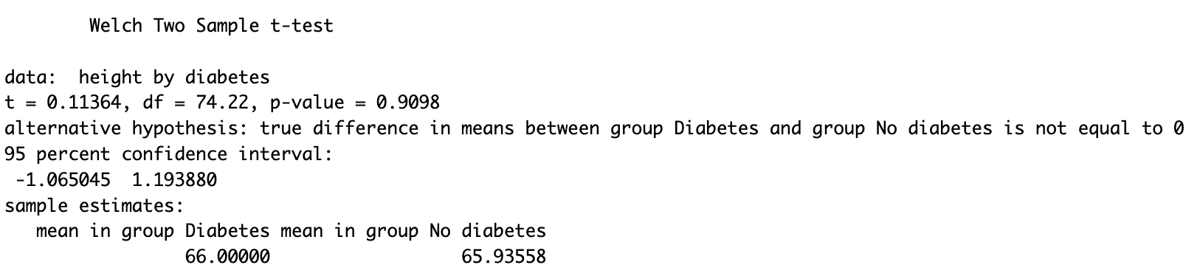
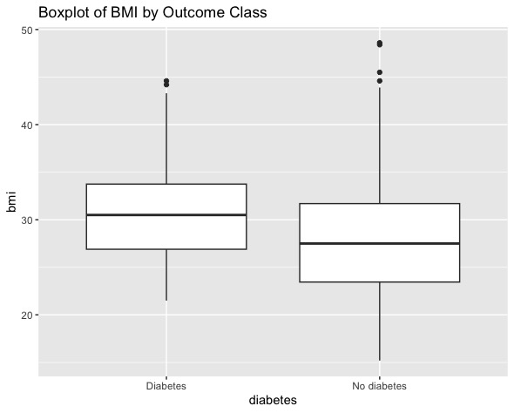
Boxplot of Height outcome class along with the T-test to check its significance:
As the p-value is greater than the significance level, we do not reject the Null Hypothesis
and conclude that mean height is statistically different in individuals with diabetes
against those who don’t have diabetes. In simple terms, Height is a not a strong factor
in determining if an individual has diabetes.
Boxplot of BMI by outcome class along with the T-test to check its significance:
As the p-value is less than the significance level, we reject the Null Hypothesis and
conclude that mean BMI level is statistically different in individuals with diabetes
against those who don’t have diabetes. In simple terms, BMI is a very important factor
in determining if an individual has diabetes.

Slide 15
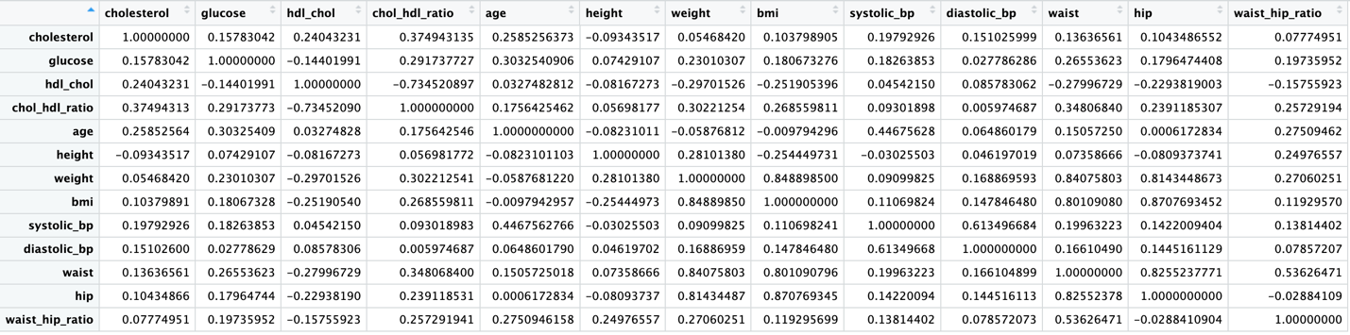
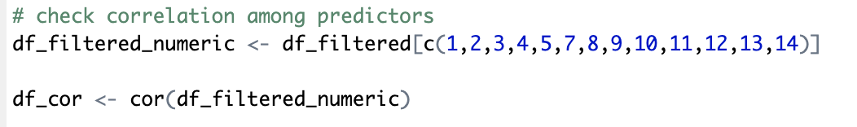
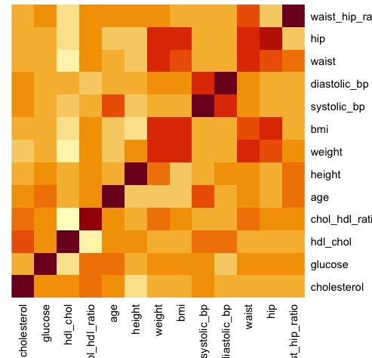
Checking Correlation among Predictors to dampen multicollinearity:
As the interpreting correlation matrix is confusing, below is a heatmap of all the predictors:

Slide 16
Variable Selection based on Exploratory data analysis:
Dropped Variables:
Patient Number- It doesn’t determine the provide any useful information.
Gender - Based on the Chi Square test, the probability for males and females having diabetes is statistically the same.
Cholesterol & HDL Chol - A derived attribute of these two measurements is used – CHOL to HDL ratio.
Height & Weight - A derived attribute of these two measurements is used – BMI.
Waist & Hip - A derived attribute of these two measurements is used – Waist to Hip ratio.
List of Shortlisted Variables:
Glucose
Chol to HDL ratio
Age
BMI
Systolic BP
Diastolic BP
Waist to Hip ratio
Diabetes Class

Slide 17
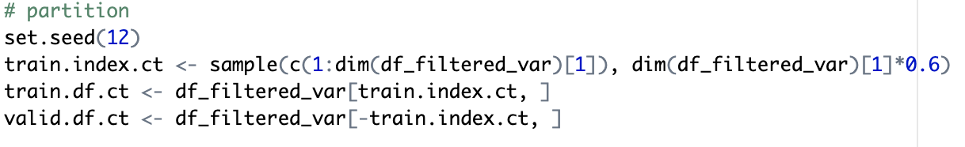
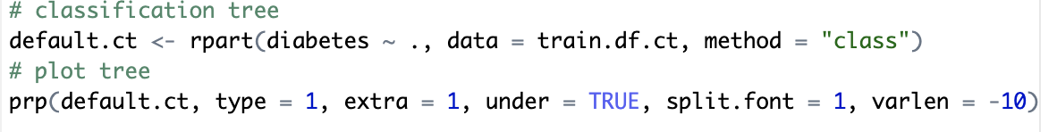
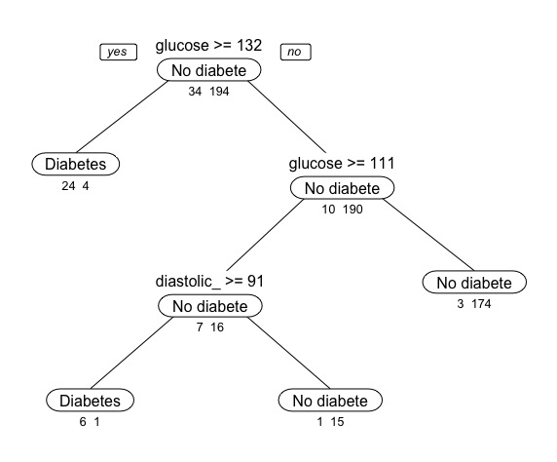
Machine Learning Models
Classification Tree:
Step 1: Partitioning the data.
Step 2: Creating the Default Tree

Slide 18
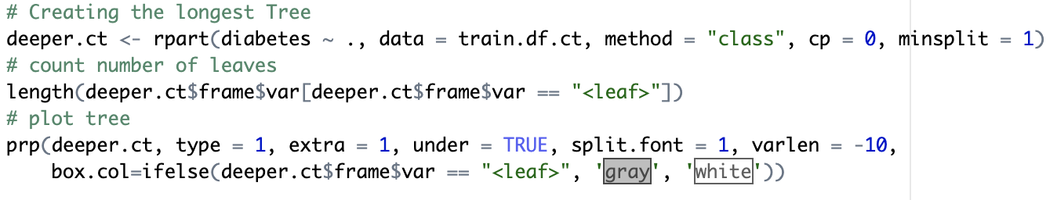
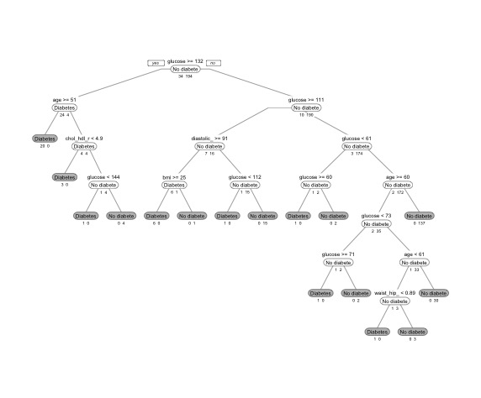
Step 3: Creating the Longest Tree
The longest tree perfectly fits the data even modeling
the noise which is what we want to avoid.
To reduce the issue of overfitting we have to trim
this deeper cut.

Slide 19
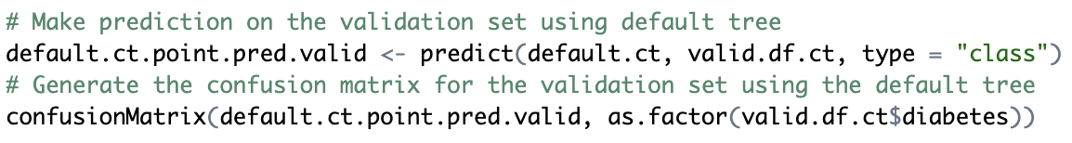
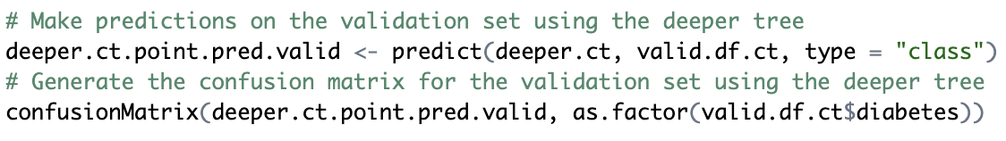
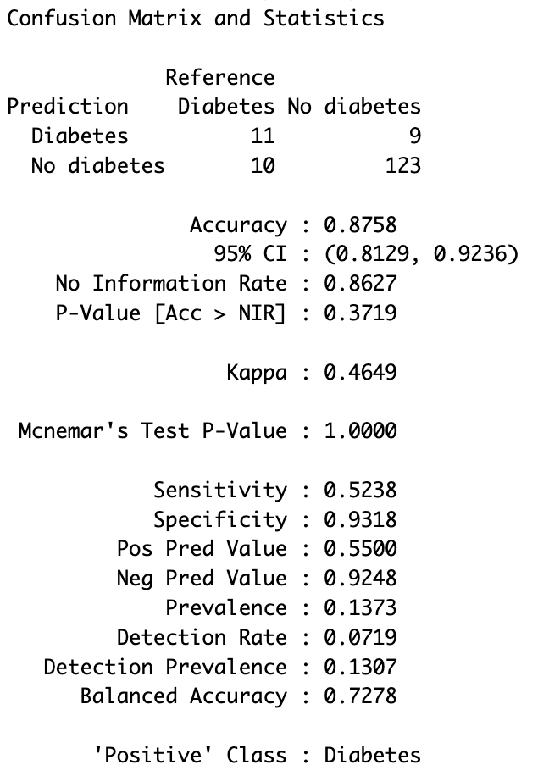
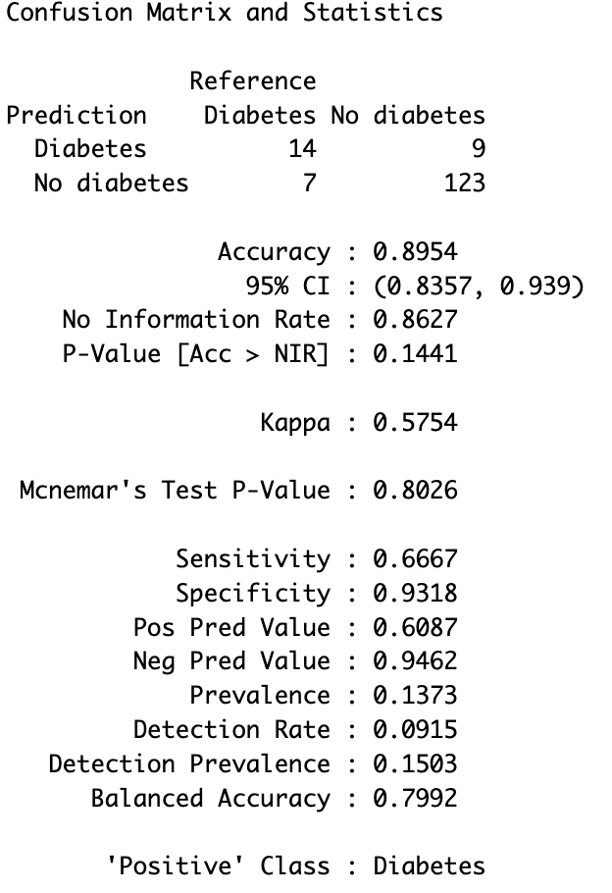
Step 4: Making predictions based on validation set for the default and deeper cur trees:
Deeper Cut Default Tree

Slide 20
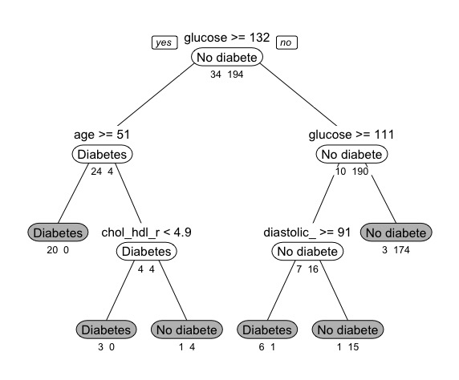
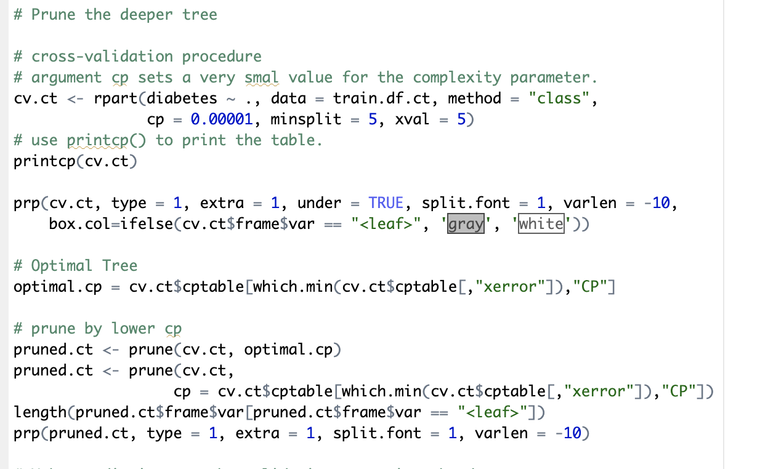
Step 5: Pruning the longest Tree:
Rules:
If the glucose level is greater or equal to 132 & Age is greater or equal to 51 then the individual has diabetes
If the glucose level is greater or equal to 132 & Age is less than 51 & Chol_HDL ratio is less than 4.9 then the individual has diabetes
If the glucose level is greater or equal to 132 & Age is less than 51 & Chol_HDL ratio is greater or equal to 4.9 then the individual does not have diabetes
If the glucose is level is less than 132 & less than 111 then the individual does not have diabetes.
If the glucose is level is less than 132 & greater or equal to 111 & diastolic BP is greater or equal to 91 then the individual has diabetes.
If the glucose is level is less than 132 & greater or equal to 111 & diastolic BP is less than 91 then the individual does not have diabetes

Slide 21
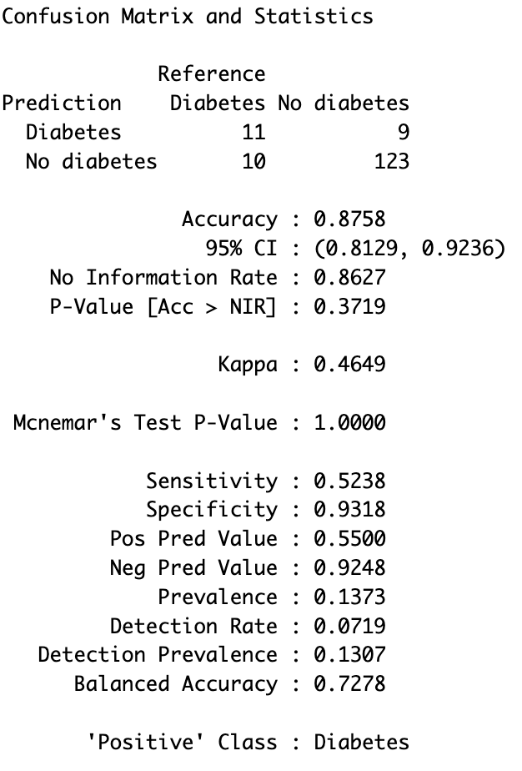
Step 6: Evaluating performance of the Pruned Tree
The pruned classification tree can predict the class of patient with an accuracy of 87.58%.

Slide 22
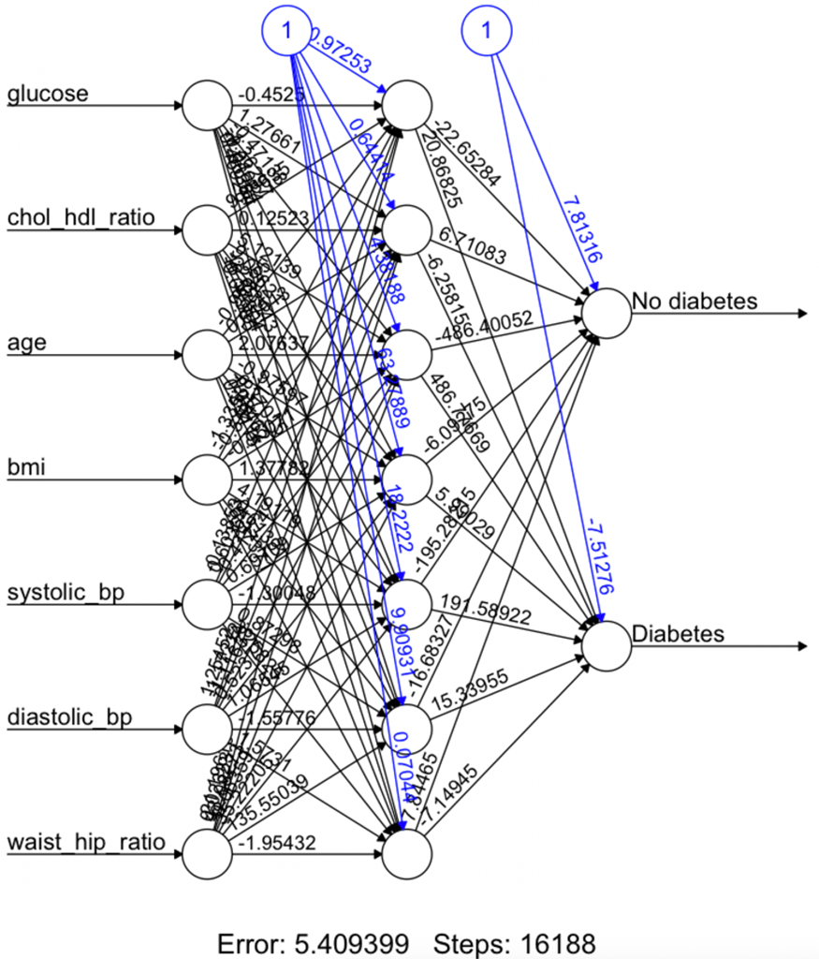
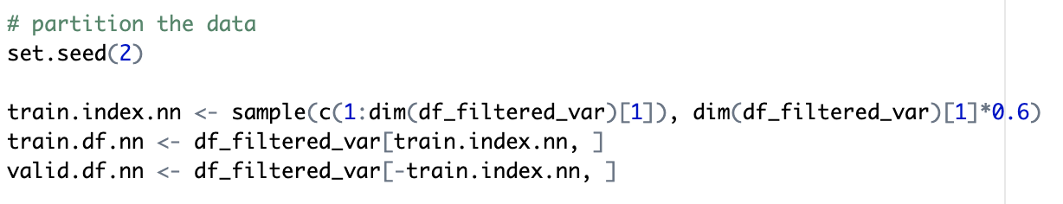
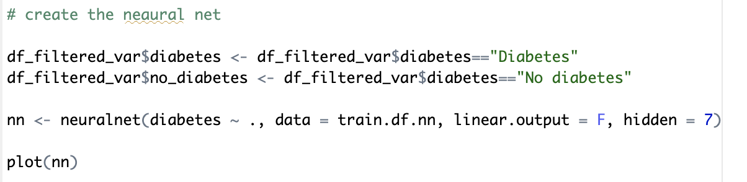
NEURAL NETS__________________________
Step 1: Partitioning the Data
Step 2: Creating the Neural Net

Slide 23
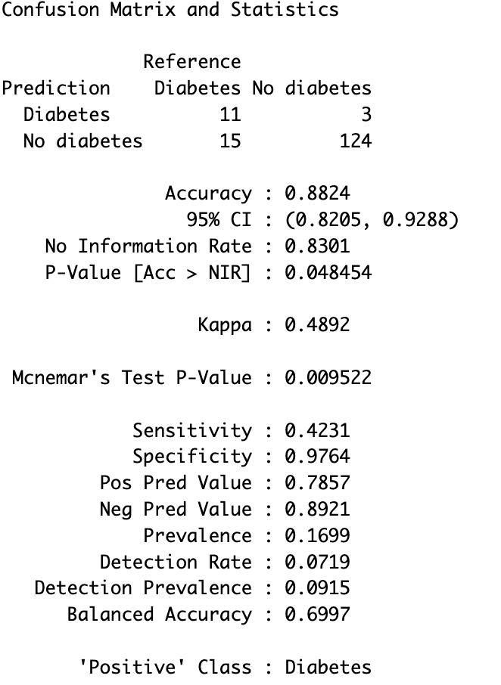
Evaluating Performance of the Neural Network:
The model can Predict the outcome class with an accuracy of 88.24%

Slide 24
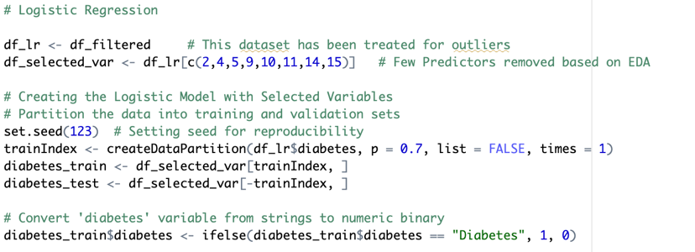
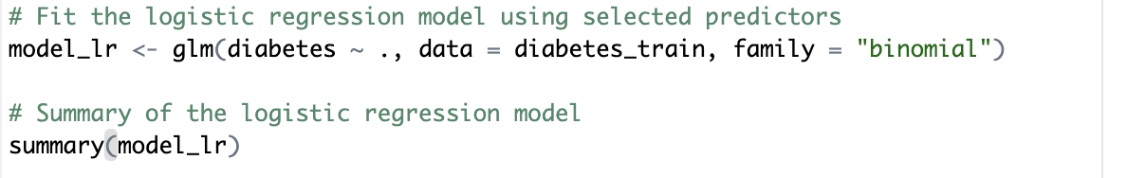
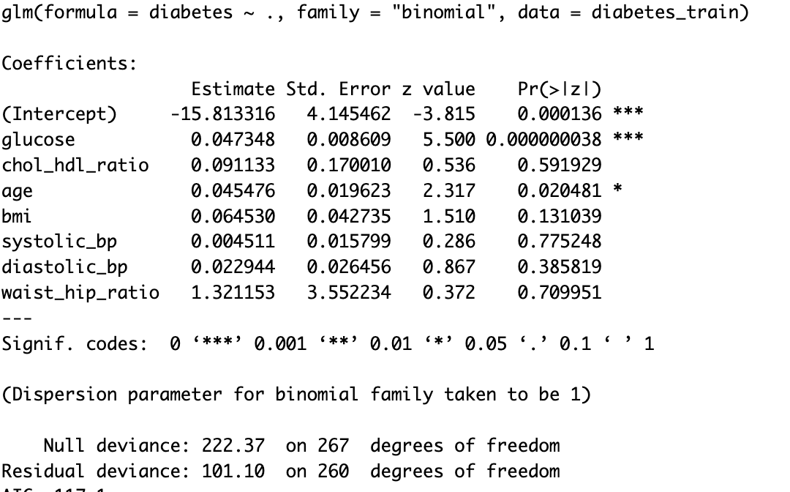
Logistic Regression:
Step 1: Defining & Partitioning the Data
Step 2: Fitting the Model

Slide 25
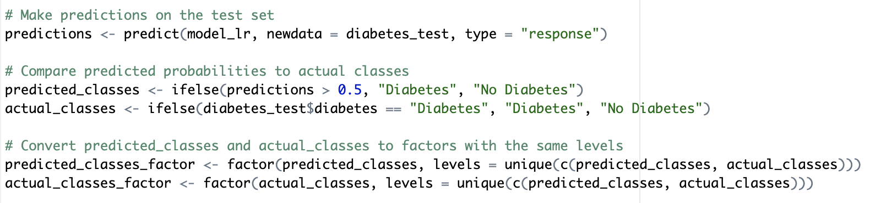
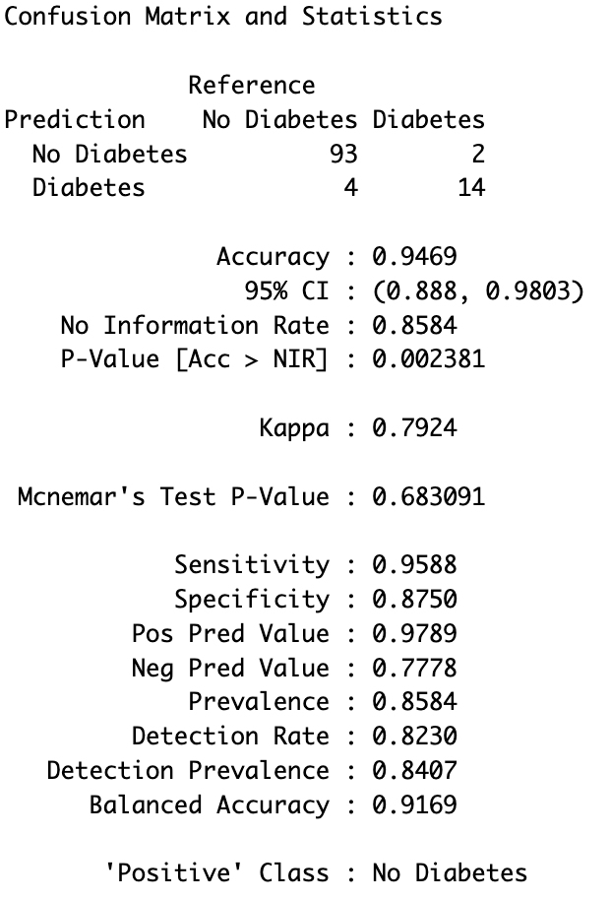
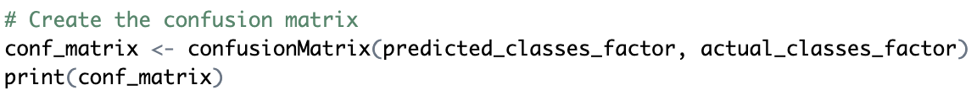
Step 3: Making Prediction on the Validation Set
Step 4: Assessing Performance

Slide 26
Neural Nets VS Regression Trees VS Logistic Regression

Slide 27
CONCLUSION
After an extensive comparison of the three models, the following conclusions have been drawn:
Logistic Regression exhibits the highest accuracy and precision among the models.
Neural Networks showcase competitive accuracy and precision.
Regression Tree displays moderate performance metrics, with balanced sensitivity and specificity, but lags Neural Networks in precision and overall accuracy.

Slide 28
THANK YOU

